Slide 1


Safe Environment
Peerapon Akkapusit KAIST Bachelor’s degree
Azamat Smagulov KAIST Bachelor’s degree

Slide 2

Air Quality
Problem
Perfect Place
To live

Slide 3

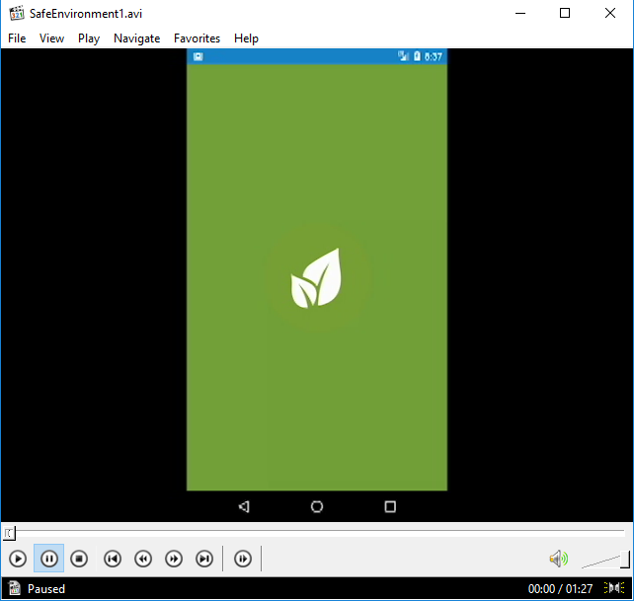
Click there

Slide 4

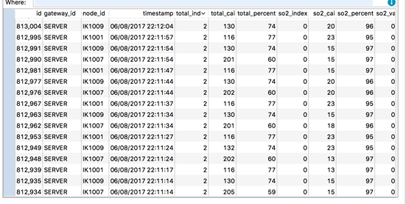
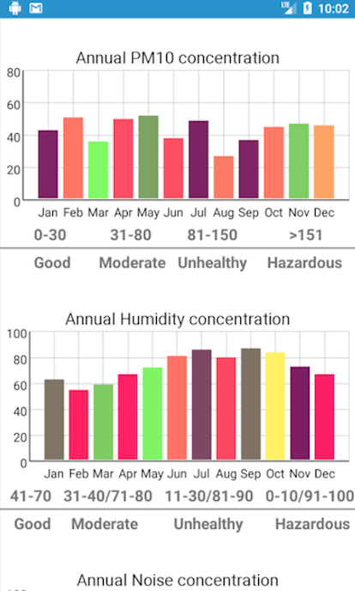

Slide 5

Let user select proper area and provide 10 best locations according to the user’s preferences
Use Crowdsourcing to improve suggestion method
Provide statistical data for each location that user selects

Slide 6
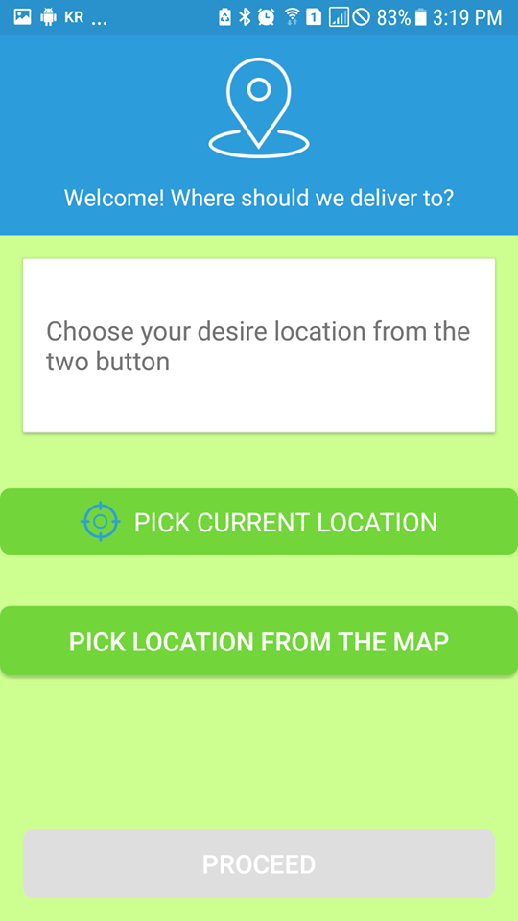
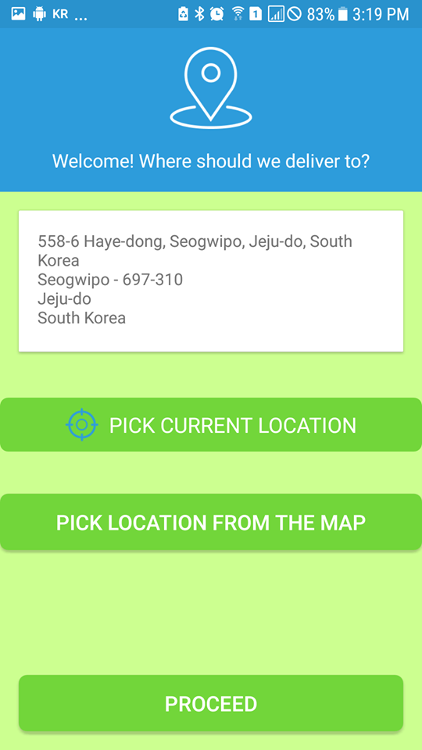

Slide 7

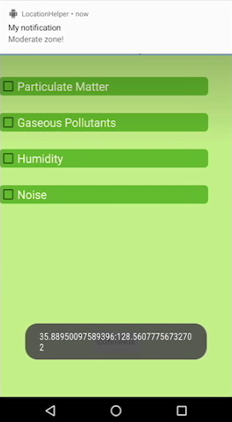

Slide 8

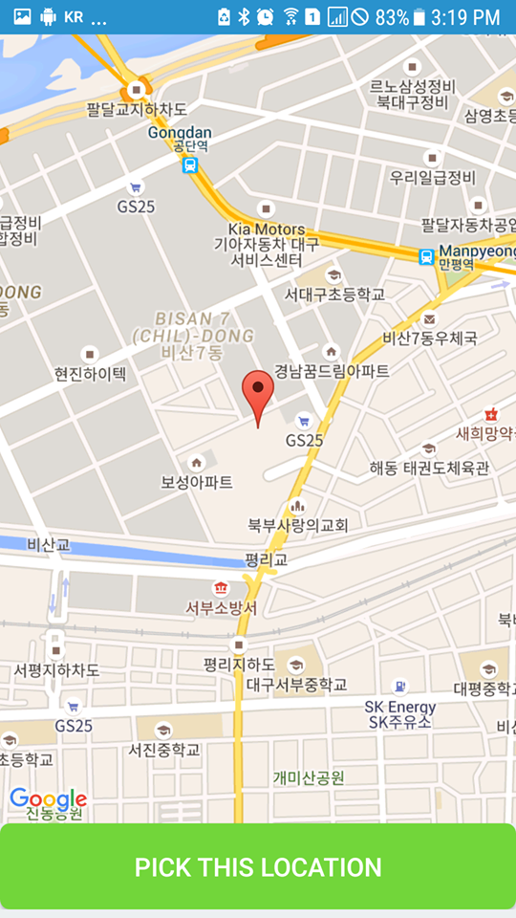
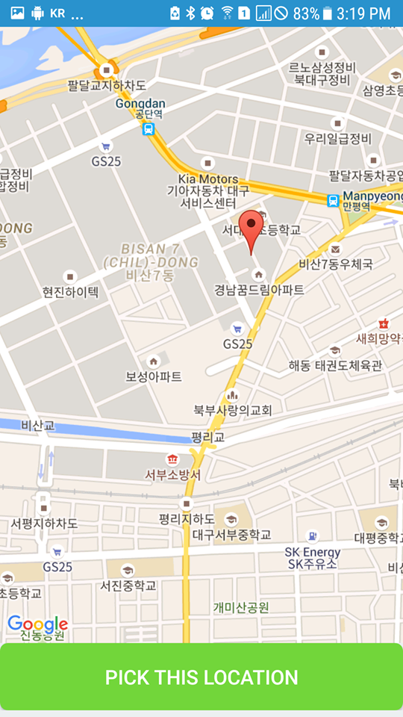

Slide 9
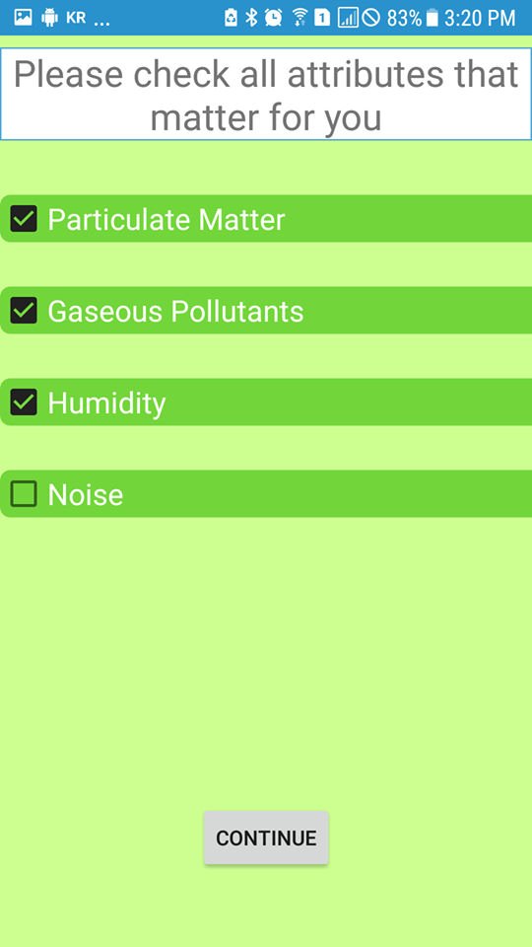

Slide 10

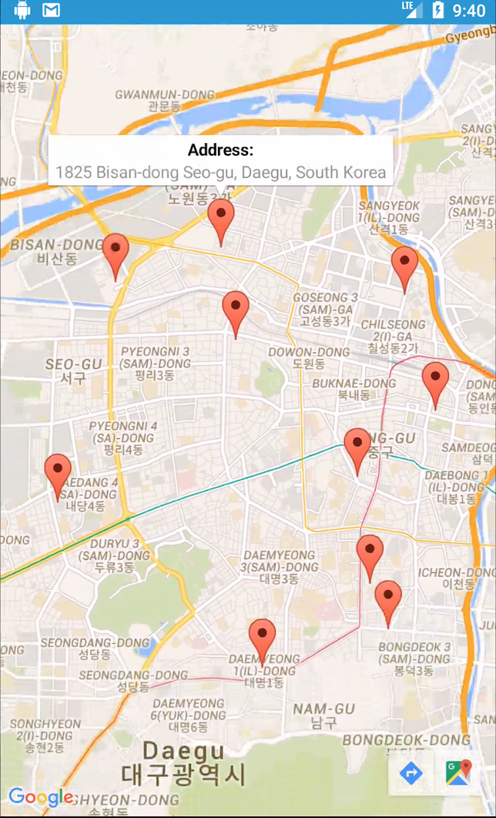
c1,c2,c3,c4,c5,c6,c7: “weights” of the attributes

Slide 11
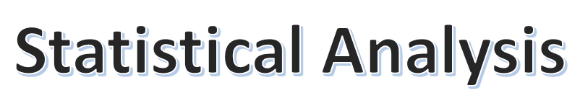

Slide 12

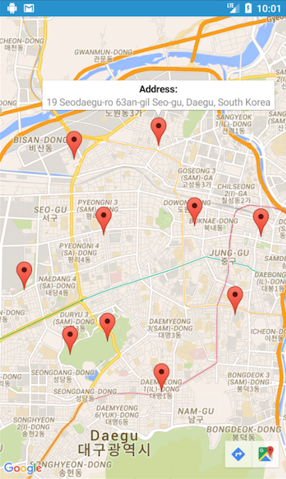
Objective of Analysis:
Get rid of certain places
Update “weights” of the attributes

Slide 13

